Slide 1
Multi-Path Fading
Wireless short course
Prof. Sundeep rangan

Slide 2
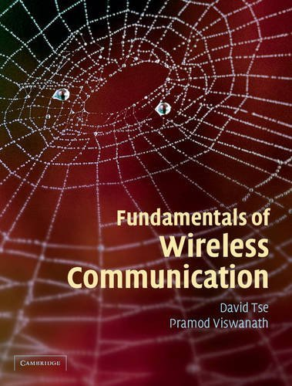
Fading
From the Introduction of a classic text:
There are two fundamental aspects of wireless communication that make the problem challenging and interesting.
…First is the phenomenon of fading …
…Second …there is significant interference …

Slide 3
Learning Objectives
Describe up and down-conversion in time- and frequency-domain
Describe the steps in the DAC and ADC including the filtering
Compute a discrete-time and continuous-time base equivalent channels from the passband
Simulate fractional delays and gains in the sampled data
Describe and simulate a deterministic multi-path wireless channel
Compute the time-varying frequency response given the path parameters
Describe a statistical model for multi-path fading
Approximately compute the coherence time and bandwidth given a channel

Slide 4
Outline
Review of Up- and Downconversion
Review of TX and RX Sampling
Doppler and Multi-Path Fading
Statistical Descriptions of Fading

Slide 5




Up- and Downconversion
Complex baseband
upconversion
Real passband
f
f
-$\frac{W}{2}$
$$\frac{W}{2}$$
downconversion
0
$$−f_{c}$$
0
$$f_{c}$$
RF communication systems:
  Information occurs and is processed in complex baseband
  Transmitted and received in real passband
Up and down-conversion: Shift center frequency of signals
Also called mixing

Slide 6
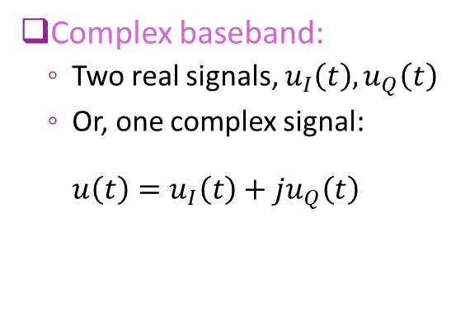
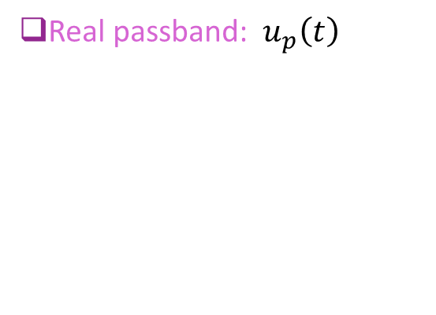
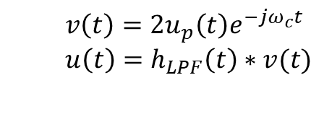

Up and Down-Conversion in Time Domain
upconversion
Complex baseband:
  Two real signals, $u_{I}\left(t\right), u_{Q}\left(t\right)$
  Or, one complex signal:
  $u\left(t\right)=u_{I}\left(t\right)+ju_{Q}\left(t\right)$
Real passband: $u_{p}\left(t\right)$
  $$u_{p}\left(t\right)=Re(u\left(t\right)e^{jω_{c}t})$$
downconversion
Note: downconversion needs:
Multiplication by 2
Low pass filtering
  $$v\left(t\right)=2u_{p}\left(t\right)e^{−jω_{c}t} \\ u\left(t\right)=h_{LPF}\left(t\right)∗v(t)$$

Slide 7

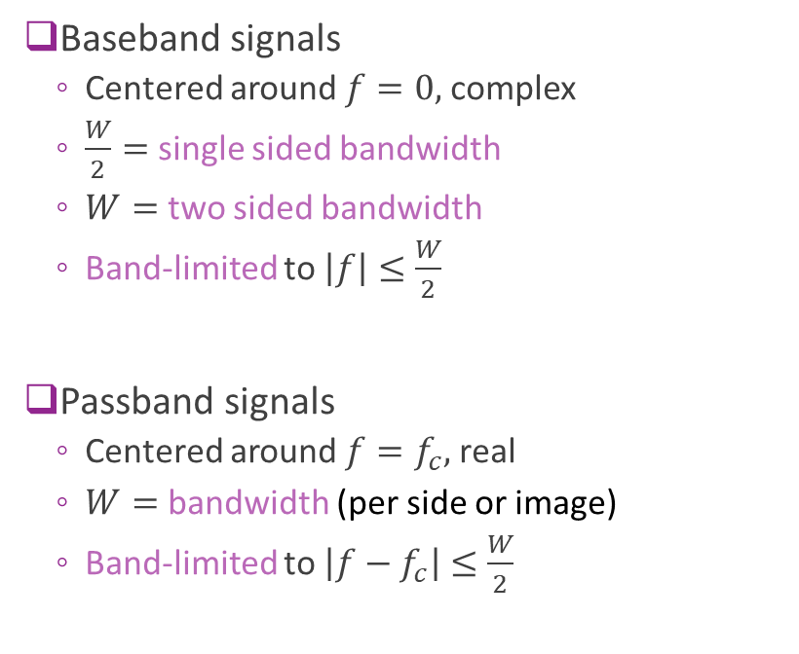






Mixing in Frequency Domain
A
Baseband signals
  Centered around $f=0,$ complex
  $\frac{W}{2}=$ single sided bandwidth
  $W=$ two sided bandwidth
  Band-limited to $\left|f\right|≤\frac{W}{2}$
Passband signals
  Centered around $f=f_{c},$ real
  $W=$ bandwidth (per side or image)
  Band-limited to $\left|{f−f}_{c}\right|≤\frac{W}{2}$
$$U(f)$$
$$−\frac{W}{2}$$
0
$$\frac{W}{2}$$
A/2
$$U(f)$$
$${−f}_{c}$$
0
$$f_{c}$$
$$W$$

Slide 8
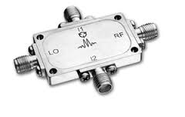
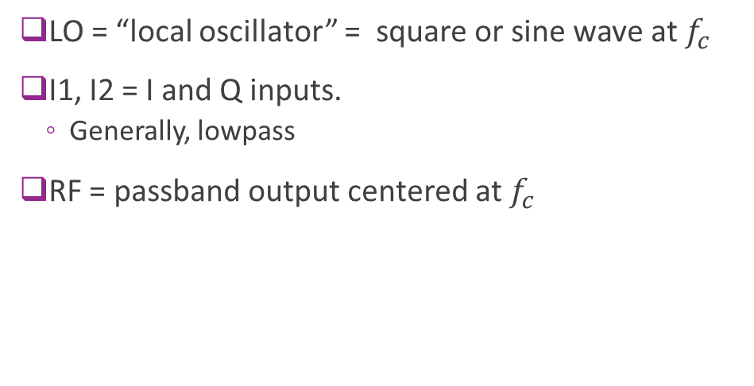
Discrete IQ Mixer
LO = “local oscillator” = square or sine wave at $f_{c}$
I1, I2 = I and Q inputs.
  Generally, lowpass
RF = passband output centered at $f_{c}$
http://www.markimicrowave.com/Mixers/IQ_Quadrature-IF_Double-Balanced/IQ-0318.aspx
Datasheet | RF [GHz] | LO [GHz] | IF [MHz] | Conversion Loss [dB] | Image Rejection [dB] | Amplitude Deviation [dB] | Phase Deviation [Degrees] | Isolations L-R [dB] | Isolations L-I [dB]
IQ-0318 | 3 to 18 | 3 to 18 | DC to 500 | 7 | 22 | 0.75 | 10 | 40 | 20

Slide 9


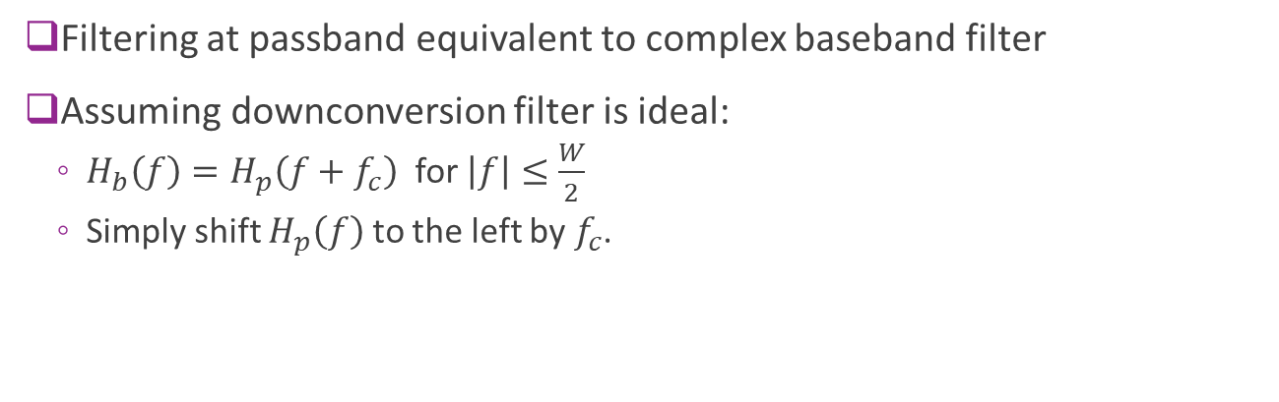








Baseband Equivalent Channel
$$f_{c}$$
$$f_{c}$$
=
$$H_{p}(f)$$
$$H_{b}(f)$$
$$y(t)$$
$$s(t)$$
$$s_{p}(t)$$
$$y_{p}(t)$$
$$y(t)$$
$$s(t)$$
Upconvert
Filter
Downconvert
Filter
Filtering at passband equivalent to complex baseband filter
Assuming downconversion filter is ideal:
  $H_{b}\left(f\right)=H_{p}\left(f+f_{c}\right)$ for $\left|f\right|≤\frac{W}{2}$
  Simply shift $H_{p}\left(f\right)$ to the left by $f_{c}$.

Slide 10
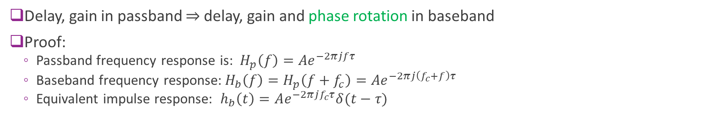
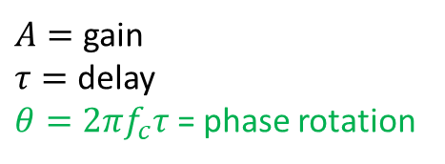
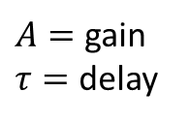


Important Special Case: Delay
Passband channel
Baseband equivalent
channel
$$h_{p}\left(t\right)=Aδ\left(t−τ\right)$$
$${ h}_{b}\left(t\right)=Ae^{−2πjf_{c}τ}δ(t−τ)$$
$A=$ gain
$τ=$ delay
$A=$ gain
$τ=$ delay
$θ=2πf_{c}τ$ = phase rotation
Delay, gain in passband $⇒$ delay, gain and phase rotation in baseband
Proof:
  Passband frequency response is: $H_{p}\left(f\right)={Ae}^{−2πjfτ}$
  Baseband frequency response:$H_{b}\left(f\right)=H_{p}\left(f+f_{c}\right)={Ae}^{−2πj\left(f_{c}+f\right)τ}$
  Equivalent impulse response: $h_{b}\left(t\right)=Ae^{−2πjf_{c}τ}δ(t−τ)$

Slide 11

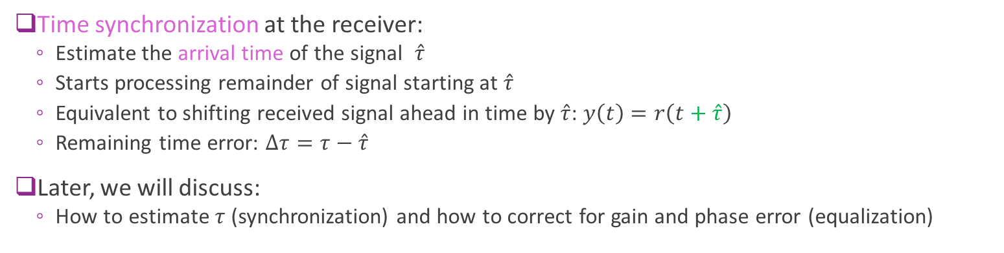
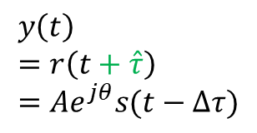

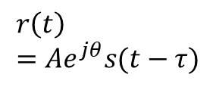



Synchronization and Delay Errors
$$y\left(t\right) \\ =r\left(t+\hat{τ}\right) \\ =Ae^{jθ}s(t−Δτ)$$
$$r\left(t\right) \\ =Ae^{jθ}s(t−τ)$$
Delay
& gain
$$s(t)$$
Shift
$$C$$
$$ACe^{jθ}$$
Delay estimate $\hat{τ}$
0
$$τ$$
Sync
Time synchronization at the receiver:
  Estimate the arrival time of the signal $\hat{τ}$
  Starts processing remainder of signal starting at $\hat{τ}$
  Equivalent to shifting received signal ahead in time by $\hat{τ}$: $y\left(t\right)$ $=r\left(t+\hat{τ}\right)$
  Remaining time error: $Δτ=τ−\hat{τ}$
Later, we will discuss:
  How to estimate $τ$ (synchronization) and how to correct for gain and phase error (equalization)

Slide 12
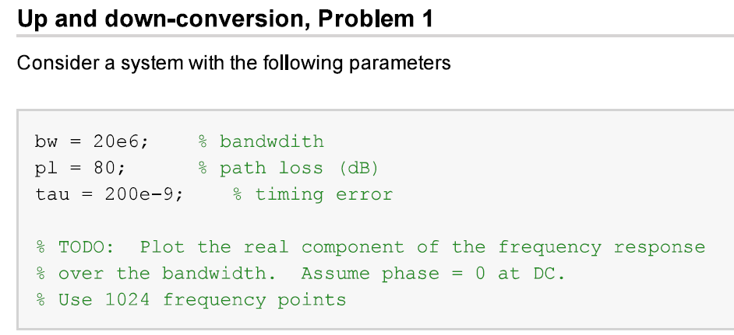
In-Class Problem

Slide 13

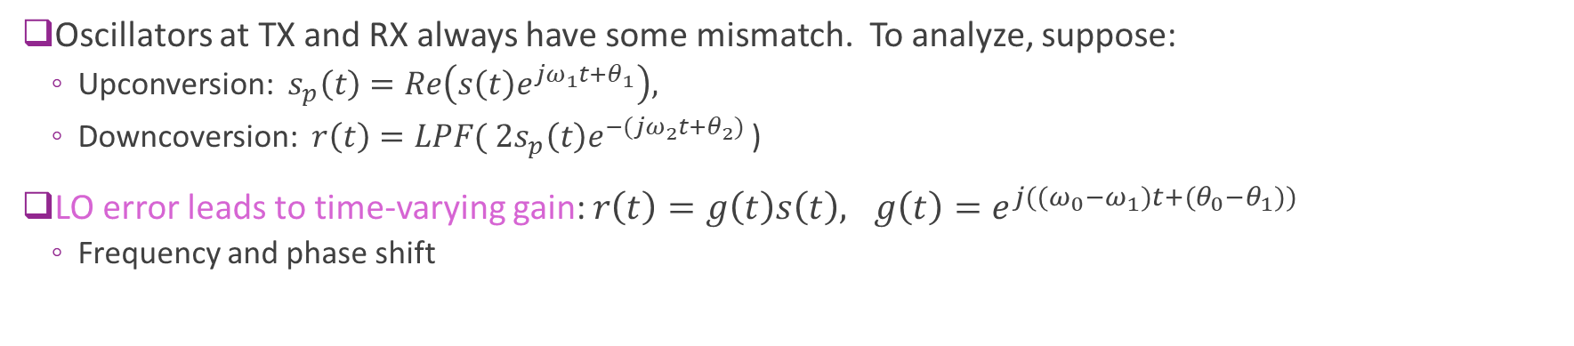





Frequency Errors
$$s(t)$$
$$×$$
$$×$$
$$r(t)=s(t)e^{j{((ω}_{0}−ω_{1})t+(θ_{0}−θ_{1}))}$$
LO 1 $ω_{1},θ_{1}$
LO 2 $ω_{2},θ_{2}$
Oscillators at TX and RX always have some mismatch. To analyze, suppose:
  Upconversion: $s_{p}\left(t\right)=Re\left(s\left(t\right)e^{jω_{1}t+θ_{1}}\right),$
  Downcoversion: $r\left(t\right)=LPF( 2s_{p}\left(t\right)e^{−(jω_{2}t+θ_{2})}$ )
LO error leads to time-varying gain: $r\left(t\right)=g\left(t\right)s\left(t\right), g\left(t\right)=e^{j{((ω}_{0}−ω_{1})t+(θ_{0}−θ_{1}))}$
  Frequency and phase shift

Slide 14
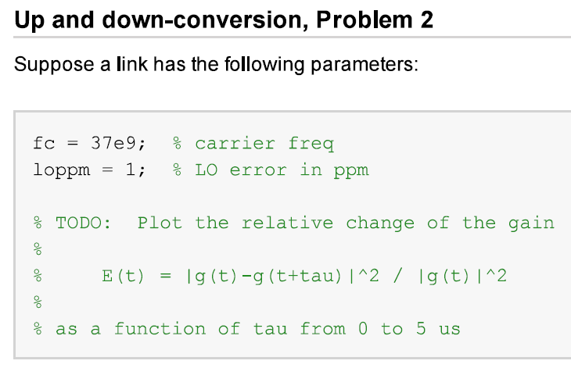
In-Class Problem

Slide 15
Outline
Review of Up- and Downconversion
Review of TX and RX Sampling
Doppler and Multi-Path Fading
Statistical Descriptions of Fading

Slide 16

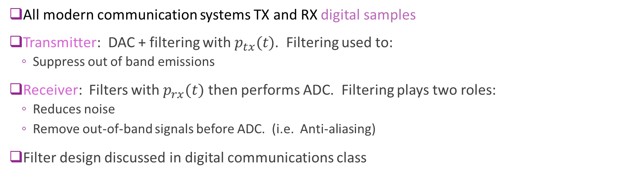








Typical Digital Communication Path
$$u_{δ}(t)$$
$$u(t)$$
$$r(t)$$
$$v(t)$$
$$s[n]$$
$$r[n]$$
TX samples
Ideal D/A
$$p_{tx}(t)$$
$$h_{chan}(t)$$
$$p_{rx}(t)$$
Ideal A/D
RX samples
All modern communication systems TX and RX digital samples
Transmitter: DAC + filtering with $p_{tx}(t)$. Filtering used to:
  Suppress out of band emissions
Receiver: Filters with $p_{rx}(t)$ then performs ADC. Filtering plays two roles:
  Reduces noise
  Remove out-of-band signals before ADC. (i.e. Anti-aliasing)
Filter design discussed in digital communications class

Slide 17
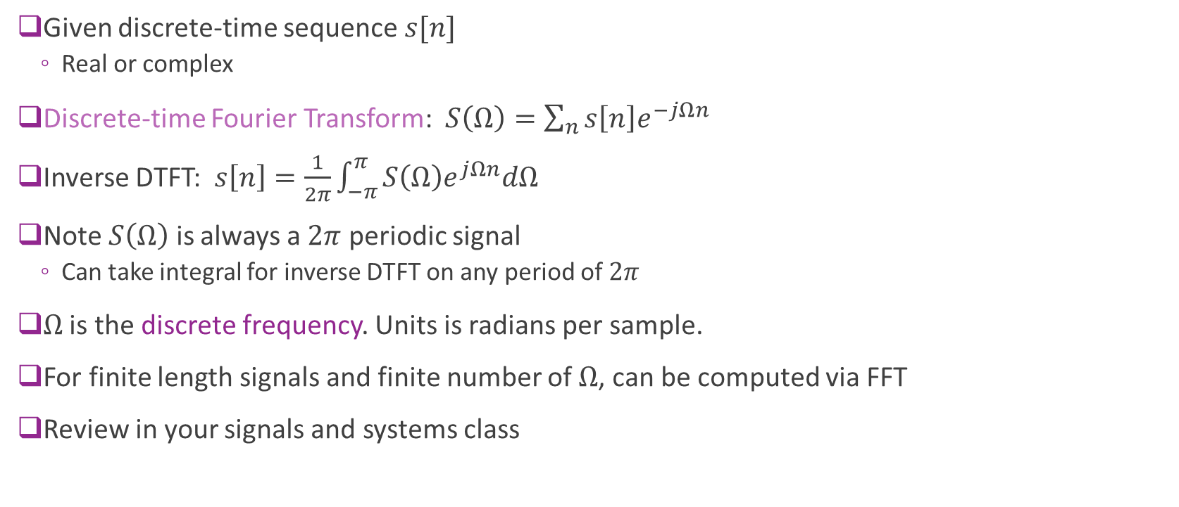
Review of DTFT
Given discrete-time sequence $s[n]$
  Real or complex
Discrete-time Fourier Transform: $S\left(Ω\right)=\sum_{n}{s\left[n\right]e^{−jΩn}}$
Inverse DTFT: $s\left[n\right]=\frac{1}{2π}\int_{−π}^{π}{S\left(Ω\right)e^{jΩn}dΩ}$
Note $S\left(Ω\right)$ is always a $2π$ periodic signal
  Can take integral for inverse DTFT on any period of $2π$
$Ω$ is the discrete frequency. Units is radians per sample.
For finite length signals and finite number of $Ω$, can be computed via FFT
Review in your signals and systems class

Slide 18
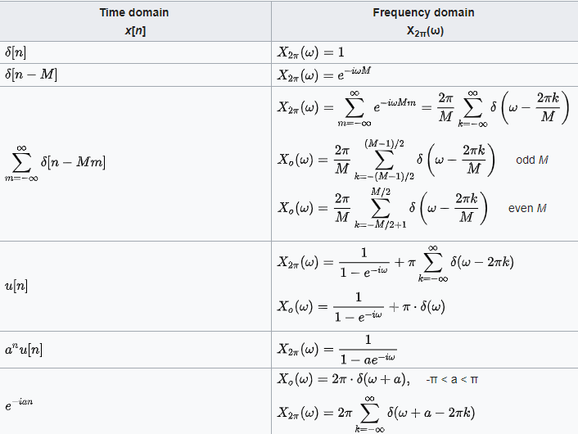
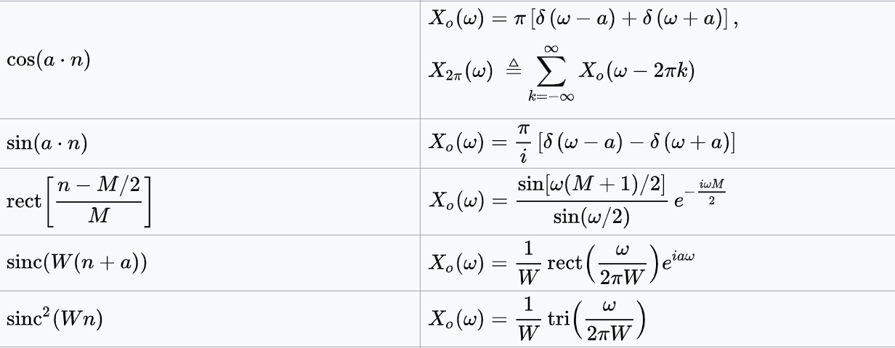
Common DTFT Pairs
See Wikipedia

Slide 19

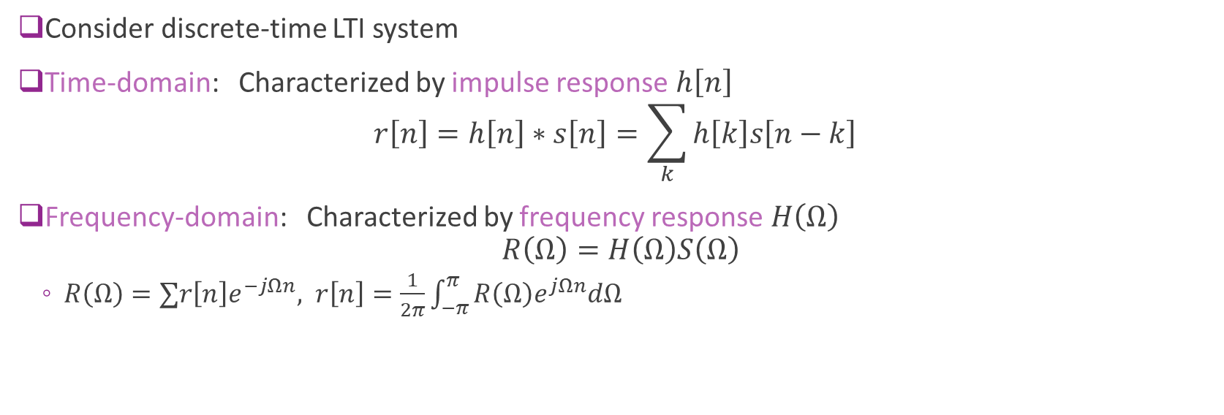


Discrete-Time Systems
$$s[n]$$
$$H(Ω)$$
$$r[n]$$
Consider discrete-time LTI system
Time-domain: Characterized by impulse response $h\left[n\right]$
$r\left[n\right]=h\left[n\right]∗s\left[n\right]=\sum_{k}{h\left[k\right]s\left[n−k\right]}$
Frequency-domain: Characterized by frequency response $H\left(Ω\right)$
$R\left(Ω\right)=H\left(Ω\right)S\left(Ω\right)$
  $R\left(Ω\right)=∑r\left[n\right]e^{−jΩn}, r\left[n\right]=\frac{1}{2π}\int_{−π}^{π}{R\left(Ω\right)e^{jΩn}dΩ}$

Slide 20

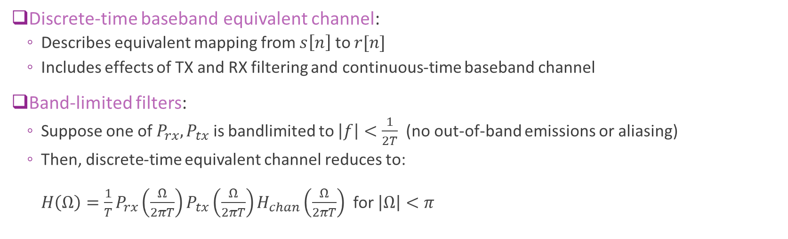







DT Equivalent Channel
$$s[n]$$
$$r[n]$$
=
$$s[n]$$
$$r[n]$$
DAC
$$p_{tx}(t)$$
$$h_{chan}(t)$$
$$p_{rx}(t)$$
ADC
$$H(Ω)$$
Discrete-time baseband equivalent channel:
  Describes equivalent mapping from $s\left[n\right]$ to $r[n]$
  Includes effects of TX and RX filtering and continuous-time baseband channel
Band-limited filters:
  Suppose one of $P_{rx}, P_{tx}$ is bandlimited to $\left|f\right|<\frac{1}{2T}$ (no out-of-band emissions or aliasing)
  Then, discrete-time equivalent channel reduces to:
  $H\left(Ω\right)=\frac{1}{T}P_{rx}\left(\frac{Ω}{2πT}\right)P_{tx}\left(\frac{Ω}{2πT}\right)H_{chan}\left(\frac{Ω}{2πT}\right)$ for $\left|Ω\right|<π$

Slide 21

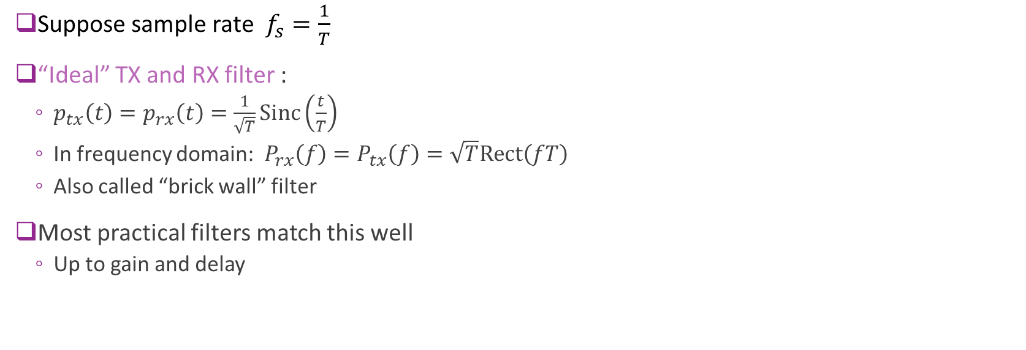

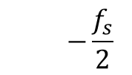
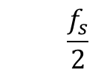

Ideal Filtering
$$s[n]$$
$$r[n]$$
=
$$s[n]$$
$$r[n]$$
DAC
$$p_{tx}(t)$$
$$h_{chan}(t)$$
$$p_{rx}(t)$$
ADC
$$H(Ω)$$
Suppose sample rate $f_{s}=\frac{1}{T}$
“Ideal” TX and RX filter :
  $p_{tx}\left(t\right)=p_{rx}\left(t\right)=\frac{1}{\sqrt{T}}Sinc\left(\frac{t}{T}\right)$
  In frequency domain: $P_{rx}\left(f\right)=P_{tx}\left(f\right)=\sqrt{T}Rect\left(fT\right)$
  Also called “brick wall” filter
Most practical filters match this well
  Up to gain and delay
  $$P_{tx}\left(f\right)=P_{rx}\left(f\right)$$
  $$\sqrt{T}$$
  $$f$$
  $$−\frac{f_{s}}{2}$$
  $$\frac{f_{s}}{2}$$

Slide 22
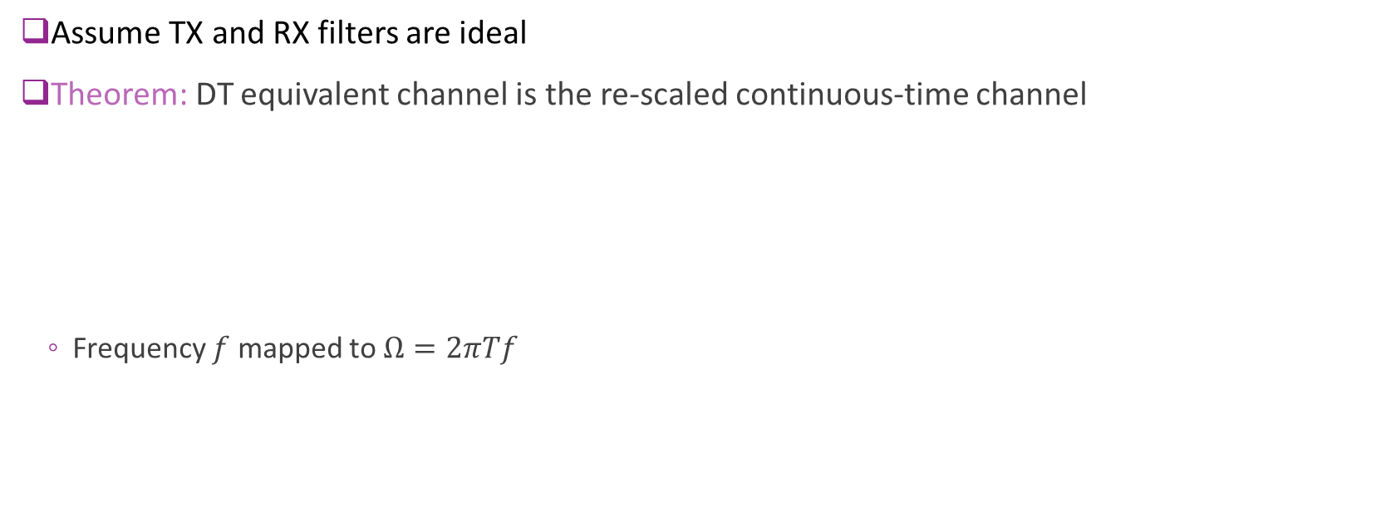
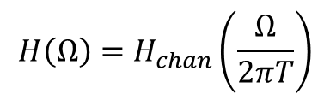
Ideal Filtering
$$s[n]$$
$$r[n]$$
=
$$s[n]$$
$$r[n]$$
DAC
$$p_{tx}(t)$$
$$h_{chan}(t)$$
$$p_{rx}(t)$$
ADC
$$H(Ω)$$
Assume TX and RX filters are ideal
Theorem: DT equivalent channel is the re-scaled continuous-time channel
  Frequency $f$ mapped to $Ω=2πTf$
$$H\left(Ω\right)=H_{chan}\left(\frac{Ω}{2πT}\right)$$

Slide 23
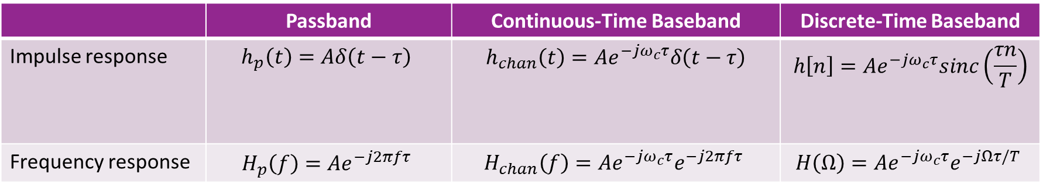
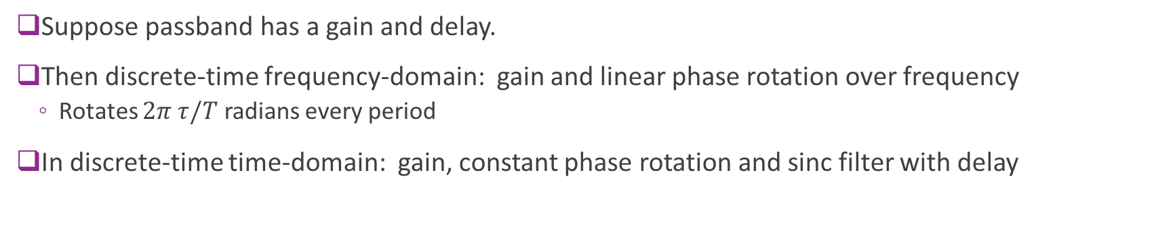
Special Case: Delay
 | Passband | Continuous-Time Baseband | Discrete-Time Baseband
Impulse response | $$h_{p}\left(t\right)=Aδ\left(t−τ\right)$$ | $$h_{chan}\left(t\right)=Ae^{−jω_{c}τ}δ\left(t−τ\right)$$ | $$h\left[n\right]=Ae^{−jω_{c}τ}sinc\left(\frac{τn}{T}\right)$$
Frequency response | $$H_{p}\left(f\right)=Ae^{−j2πfτ}$$ | $$H_{chan}\left(f\right)=Ae^{−jω_{c}τ}e^{−j2πfτ}$$ | $$H\left(Ω\right)=Ae^{−jω_{c}τ}e^{−jΩτ/T}$$
Suppose passband has a gain and delay.
Then discrete-time frequency-domain: gain and linear phase rotation over frequency
  Rotates $2π τ/T$ radians every period
In discrete-time time-domain: gain, constant phase rotation and sinc filter with delay

Slide 24
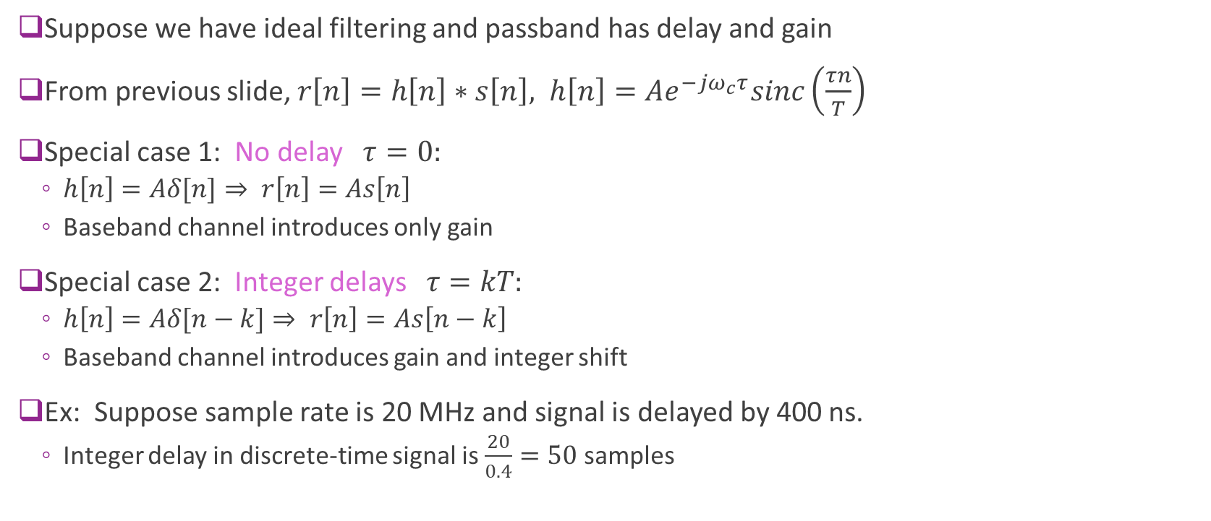
Sinc Filter with Integer Delays
Suppose we have ideal filtering and passband has delay and gain
From previous slide, $r\left[n\right]=h\left[n\right]∗s\left[n\right], h\left[n\right]=Ae^{−jω_{c}τ}sinc\left(\frac{τn}{T}\right)$
Special case 1: No delay $τ=0:$
  $h\left[n\right]=Aδ[n]⇒ r\left[n\right]=As\left[n\right]$
  Baseband channel introduces only gain
Special case 2: Integer delays $τ=kT:$
  $h\left[n\right]=Aδ[n−k]⇒ r\left[n\right]=As\left[n−k\right]$
  Baseband channel introduces gain and integer shift
Ex: Suppose sample rate is 20 MHz and signal is delayed by 400 ns.
  Integer delay in discrete-time signal is $\frac{20}{0.4}=50$ samples

Slide 25
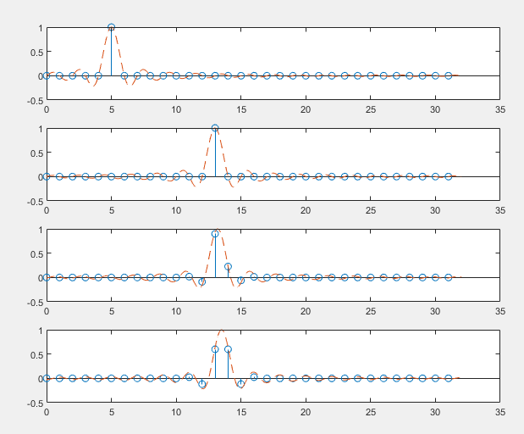
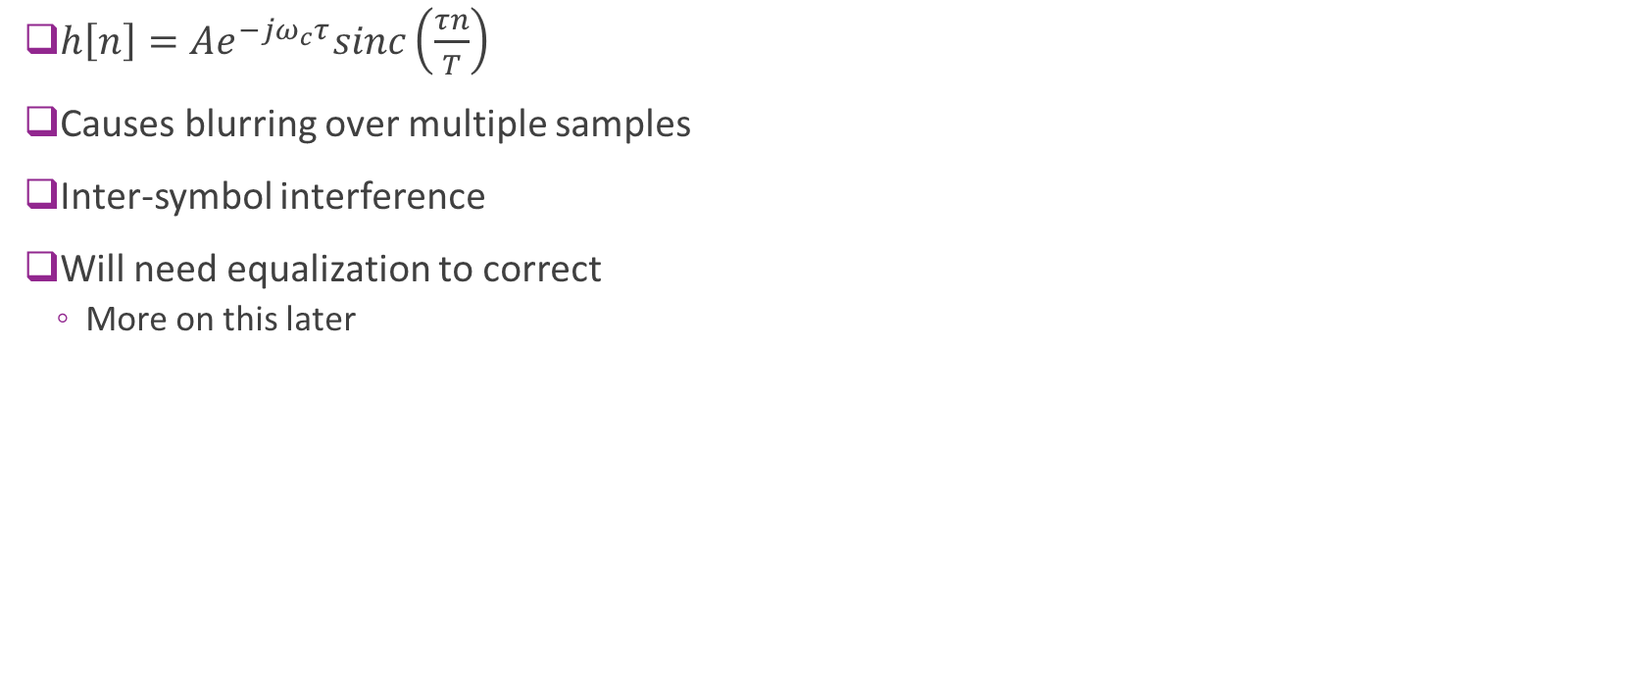




Sinc Pulses with Fractional Delay
$h\left[n\right]=Ae^{−jω_{c}τ}sinc\left(\frac{τn}{T}\right)$
Causes blurring over multiple samples
Inter-symbol interference
Will need equalization to correct
  More on this later
$$τ=0$$
$$τ=8$$
$$τ=8.2$$
$$τ=8.5$$

Slide 26
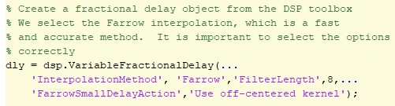

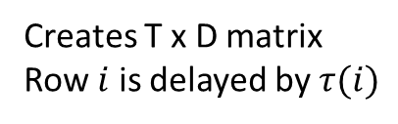
Simulating Fractional Delays in MATLAB
Code on previous slide was create with DSP toolbox
Creates T x D matrix
Row $i$ is delayed by $τ(i)$

Slide 27
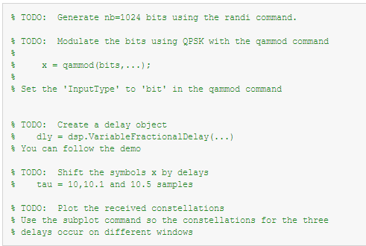
In-Class Problem:
Fractional Delays on Constellations

Slide 28
Outline
Review of Up- and Downconversion
Review of TX and RX Sampling
Doppler and Multi-Path Fading
Statistical Descriptions of Fading

Slide 29

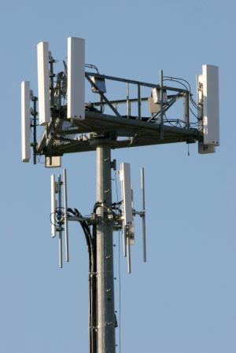

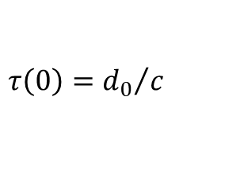
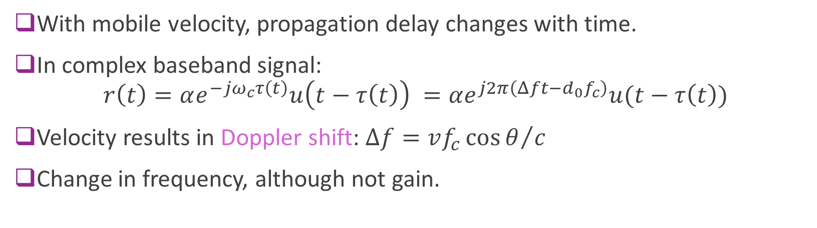
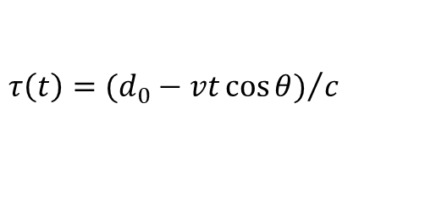

Doppler Shift
$$τ\left(t\right)={(d_{0}−vt\cos{θ)}}/c$$
Mobile velocity $v$
$$θ$$
$$τ\left(0\right)={d_{0}}/c$$
With mobile velocity, propagation delay changes with time.
In complex baseband signal:
$r\left(t\right)=αe^{−{jω}_{c}τ\left(t\right)}u\left(t−τ\left(t\right)\right) =αe^{j2π\left(Δft−d_{0}f_{c}\right)}u(t−τ\left(t\right))$
Velocity results in Doppler shift: $Δf={vf_{c}\cos{θ}}/c$
Change in frequency, although not gain.

Slide 30

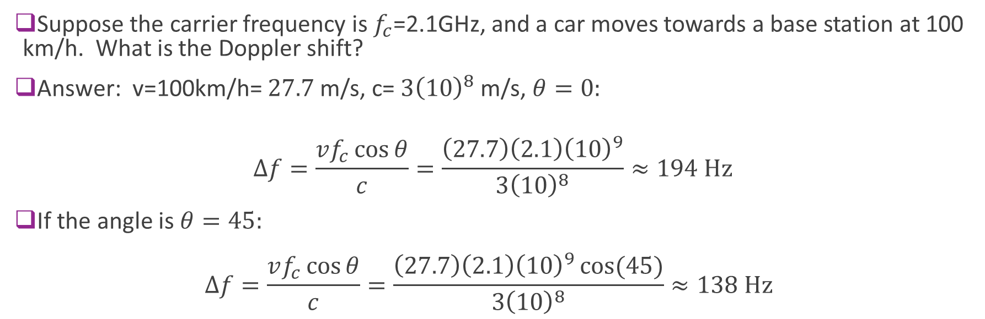
Sample Problem
v=100 km/h
Suppose the carrier frequency is $f_{c}$=2.1GHz, and a car moves towards a base station at 100 km/h. What is the Doppler shift?
Answer: v=100km/h= $27.7$m/s, c= $3{\left(10\right)}^{8}$m/s, $θ=0:$
$$Δf=\frac{vf_{c}\cos{θ}}{c}=\frac{\left(27.7\right)\left(2.1\right){\left(10\right)}^{9}}{3{\left(10\right)}^{8}}≈194 \text{Hz}$$
If the angle is $θ=45:$
$Δf=\frac{vf_{c}\cos{θ}}{c}=\frac{\left(27.7\right)\left(2.1\right){\left(10\right)}^{9}\cos{(45)}}{3{\left(10\right)}^{8}}≈138 \text{Hz}$

Slide 31
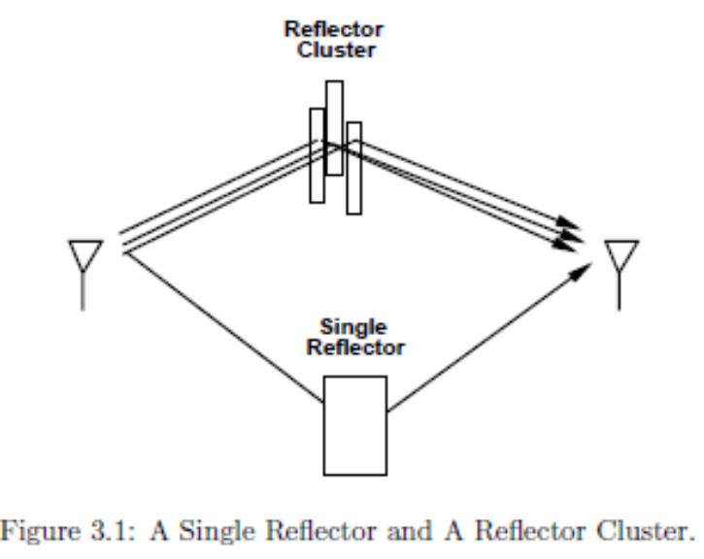
Multipath Channel
Most channel consists of many paths
  Direct paths
  Reflections, transmissions, diffraction, …
  LOS and NLOS paths
Each path has different
  Delay
  Phase
  Gain

Slide 32
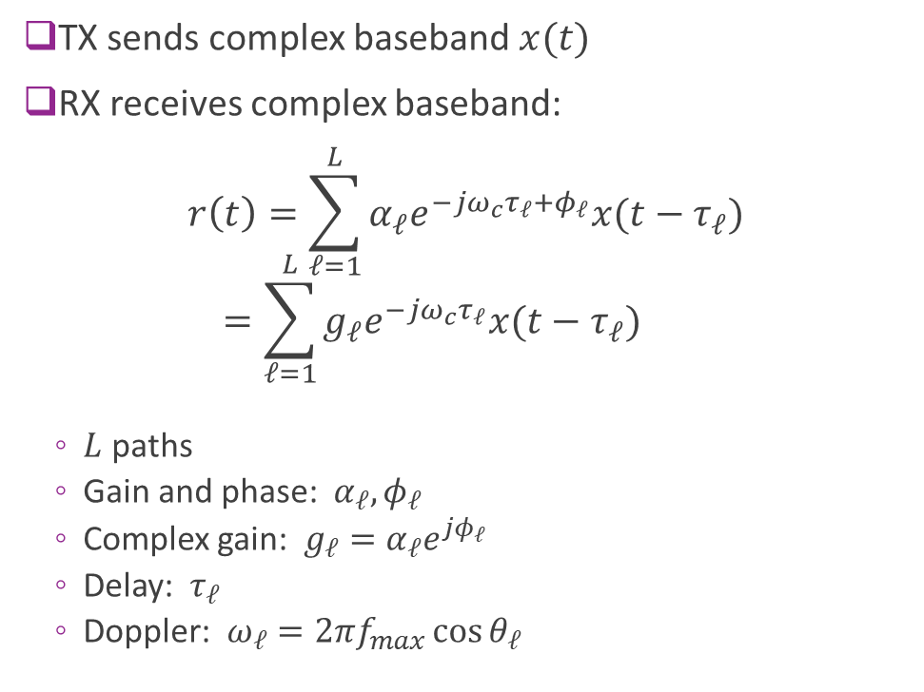

Baseband Model
TX sends complex baseband $x(t)$
RX receives complex baseband:
$r\left(t\right)=\sum_{ℓ=1}^{L}{α_{ℓ}e^{−jω_{c}τ_{ℓ}+φ_{ℓ}}x(t−τ_{ℓ})}$
$=\sum_{ℓ=1}^{L}{g_{ℓ}e^{−jω_{c}τ_{ℓ}}x(t−τ_{ℓ})}$
  $L$ paths
  Gain and phase: $α_{ℓ}, φ_{ℓ}$
  Complex gain: $g_{ℓ}=α_{ℓ}e^{jφ_{ℓ}}$
  Delay: $τ_{ℓ}$
  Doppler: $ω_{ℓ}=2πf_{max}\cos{θ_{ℓ}}$
$$(α_{ℓ},τ_{ℓ},φ_{ℓ})$$

Slide 33
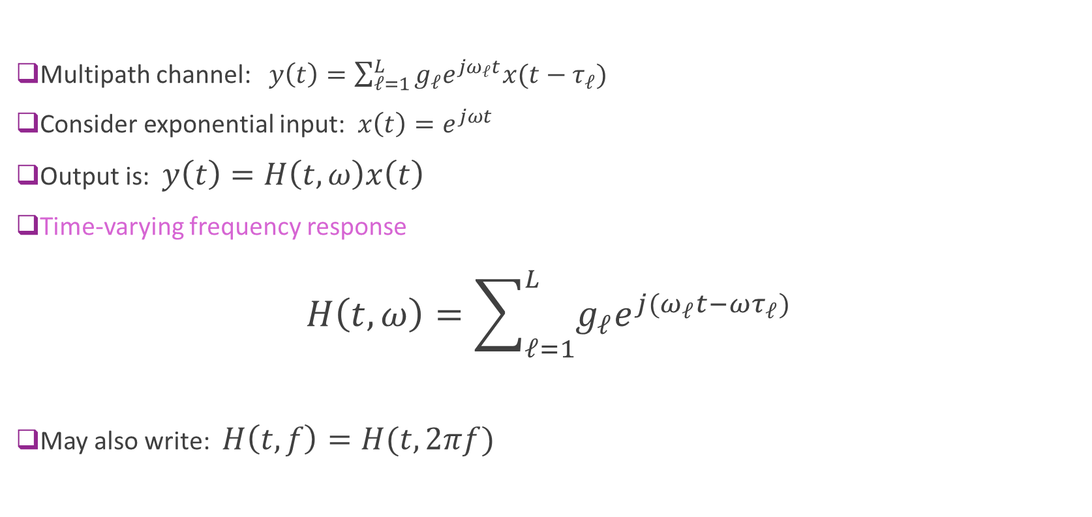
Time-Varying Frequency Response
Multipath channel: $y\left(t\right)=\sum_{ℓ=1}^{L}{g_{ℓ}e^{jω_{ℓ}t}x(t−τ_{ℓ})}$
Consider exponential input: $x\left(t\right)=e^{jωt}$
Output is: $y\left(t\right)=H\left(t,ω\right)x\left(t\right)$
Time-varying frequency response
$H\left(t,ω\right)=\sum_{ℓ=1}^{L}{g_{ℓ}e^{j(ω_{ℓ}t−ωτ_{ℓ})}}$
May also write: $H\left(t,f\right)=H(t,2πf)$

Slide 34

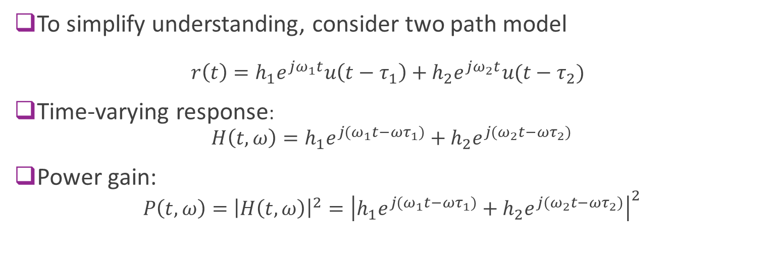


Example with Two Paths
$$τ_{1},θ_{1}$$
$$τ_{2},θ_{2}$$
To simplify understanding, consider two path model
$r\left(t\right)=h_{1}e^{jω_{1}t}u\left(t−τ_{1}\right)+h_{2}e^{jω_{2}t}u(t−τ_{2})$
Time-varying response:
$H\left(t,ω\right)=h_{1}e^{j{(ω}_{1}t−{ωτ}_{1})}+h_{2}e^{j{(ω}_{2}t−{ωτ}_{2})}$
Power gain:
$P\left(t,ω\right)={\left|H\left(t,ω\right)\right|}^{2}={\left|h_{1}e^{j{(ω}_{1}t−{ωτ}_{1})}+h_{2}e^{j{(ω}_{2}t−{ωτ}_{2})}\right|}^{2}$
$$ω_{i}=2 πf_{dmax}\cos{θ_{i}}$$

Slide 35
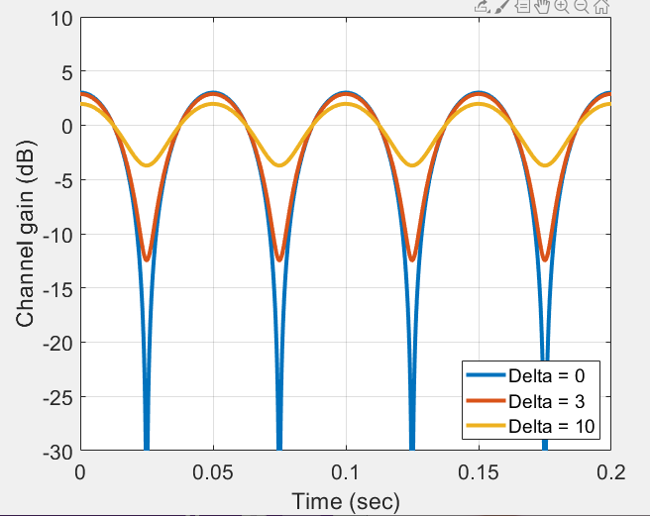

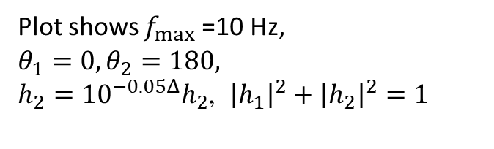
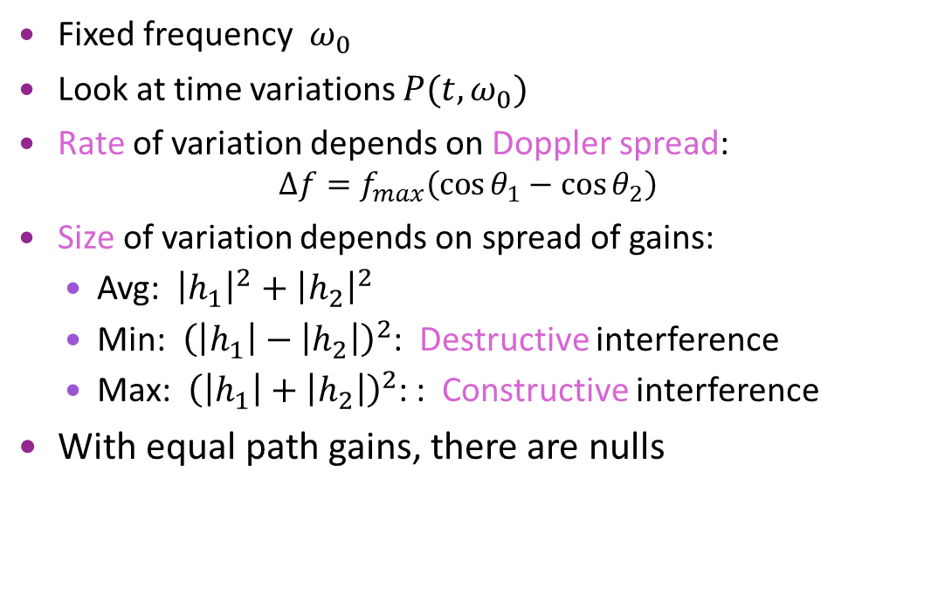
Variation in Time
$$P\left(t,ω_{0}\right)={\left|h_{1}e^{j{(ω}_{1}t+φ_{1})}+h_{2}e^{j{(ω}_{2}t+φ_{2})}\right|}^{2}$$
Fixed frequency $ω_{0}$
Look at time variations $P(t,ω_{0})$
Rate of variation depends on Doppler spread:
$Δf=f_{max}\left(\cos{θ_{1}−\cos{θ_{2}}}\right)$
Size of variation depends on spread of gains:
  Avg: ${\left|h_{1}\right|}^{2}+{\left|h_{2}\right|}^{2}$
  Min: ${\left(\left|h_{1}\right|−\left|h_{2}\right|\right)}^{2}$: Destructive interference
  Max: ${\left(\left|h_{1}\right|+\left|h_{2}\right|\right)}^{2}$: : Constructive interference
With equal path gains, there are nulls
Plot shows $f_{max}⁡$=10 Hz,
$θ_{1}=0, θ_{2}=180,$
$h_{2}={10}^{−0.05Δ}h_{2}$, ${\left|h_{1}\right|}^{2}+$ ${\left|h_{2}\right|}^{2}=1$

Slide 36
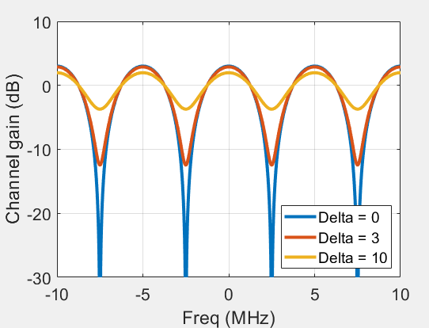

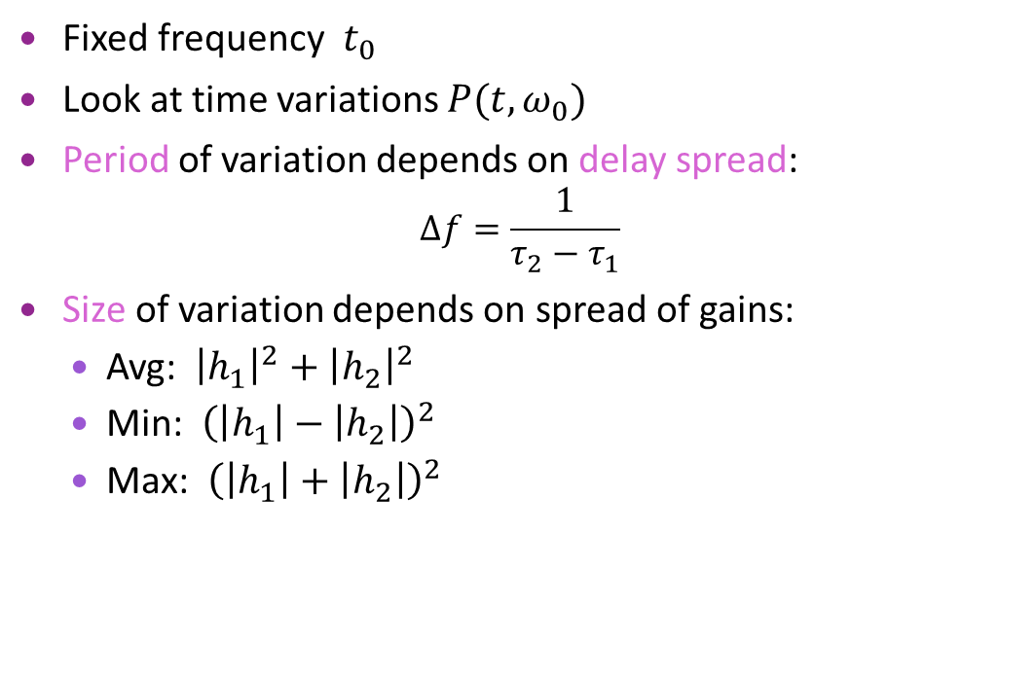

Variation in Frequency
$$P\left(t_{0},ω\right)={\left|h_{1}e^{j(ωτ_{1}+φ_{1})}+h_{2}e^{j(ωτ_{2}+φ_{2})}\right|}^{2}$$
Fixed frequency $t_{0}$
Look at time variations $P(t,ω_{0})$
Period of variation depends on delay spread:
$Δf=\frac{1}{τ_{2}−τ_{1}}$
Size of variation depends on spread of gains:
  Avg: ${\left|h_{1}\right|}^{2}+{\left|h_{2}\right|}^{2}$
  Min: ${\left(\left|h_{1}\right|−\left|h_{2}\right|\right)}^{2}$
  Max: ${\left(\left|h_{1}\right|+\left|h_{2}\right|\right)}^{2}$
Plot shows
$τ_{1}=0, τ_{2}=200$ ns,
$h_{2}={10}^{−0.05Δ}h_{2}$, ${\left|h_{1}\right|}^{2}+$ ${\left|h_{2}\right|}^{2}=1$

Slide 37

Fading
Over time and frequency, paths can either
  Constructively interfere $⇒$ Peaks
  Destructively interfere $⇒$ Nulls
Process is called fading
  Intermittent channel quality
One of the most significant challenges in wireless
Later, we will discuss how to overcome fading

Slide 38

Narrowband Assumption
For two path model:
$P\left(t_{0},ω\right)={\left|h_{1}e^{j{(τ}_{1}ω+φ_{1})}+h_{2}e^{j{(τ}_{2}ω +φ_{2})}\right|}^{2}$
Period of variation in $f$ = $\left|τ_{1}−τ_{2}\right|$
Suppose that $u\left(t\right)$ has bandwidth $W$
Narrowband assumption valid when $\left|τ_{1}−τ_{2}\right|≪W^{−1}$
$\left|τ_{1}−τ_{2}\right|$ is the delay spread
Represents max difference in path lengths

Slide 39



OFDM Time-Frequency Grid
Subcarrier
spacing
$Δf=\frac{1}{T}$
OFDM modulation: Widely-used method
  4G and 5G cellular systems
  Many 802.11 standards
Divide channel into sub-carriers and OFDM symbols
  Resource element: One time-frequency point
Data is transmitted is an array: $X\left[n,k\right]$
  $k=$ OFDM symbol index
  $n$ = subcarrier index
  One complex value per RE.
  Called a modulation symbol
See digital communication class
  We will also review again when we discuss equalization
Frequency
OFDM symbol
$T_{sym}$
Time

Slide 40

OFDM Channel with Fading
OFDM channel acts as multiplication:
Under normal operation (delay spread is contained in CP):
$Y\left[k,n\right]=H\left[k,n\right] X[k,n]$
OFDM channel gains can be computed from the multi-path components
$H\left[k,n\right]=\sum_{ℓ=1}^{L}{\sqrt{E_{ℓ}}e^{−2πj (Tkf_{ℓ}+Snτ_{ℓ}+φ_{ℓ})}}$
  $T=$ OFDM symbol time, $S=$ sub-carrier spacing
  For each path: $f_{ℓ}=$Doppler shift, $τ_{ℓ}=$Delay, $φ_{ℓ}=$ phase of path, $E_{ℓ}=$ path received energy
RX symbols
Channel
TX symbols

Slide 41

Summary
Doppler to a single path causes a phase rotation
  Gain is constant
With multiple paths, gain varies
  Constructive and destructive interference of paths
Described by a time-varying frequency response $H\left(t,f\right)$
  Variations is time due to Doppler spread
  Variations in frequency due to delay spread

Slide 42

In-Class Exercise: OFDM Channel Response

Slide 43
Outline
Review of Up- and Downconversion
Review of TX and RX Sampling
Doppler and Multi-Path Fading
Statistical Descriptions of Fading

Slide 44


Random Path Statistical Model
RX signal has many random, independent paths
Time-varying frequency response:
$h\left(t,f\right)=\frac{1}{\sqrt{L}}\sum_{ℓ=1}^{L}{g_{ℓ}e^{2πi(tf_{d}\cos{θ_{ℓ}}+fτ_{ℓ})}}$
  Assume $(g_{ℓ},θ_{ℓ}$) i.i.d.
  Path gains: $g_{ℓ}$ are zero mean $E{\left|g_{ℓ}\right|}^{2}=P$
By Central Limit Theorem, $h(t)$ is a complex Gaussian
  $h\left(t,f\right)\sim CN(0,P)$
  Independent real and imaginary components
  Variance $P/2$ for real and imaginary components
$$g_{ℓ},τ_{ℓ},θ_{ℓ}$$
Direction of motion

Slide 45


Rayleigh Distribution
Probability distribution
$h\sim CN(0,P)$ complex Gaussian
$R=|h|$ magnitude
Represents amplitude gain
Has Rayleigh distribution:
  PDF: $p\left(r\right)=\frac{2r}{P}e^{−{r^{2}}/P}$
  CDF: $P\left(R≤r\right)=1−e^{−{r^{2}}/P}$
  Second moment: $ER^{2}=P$

Slide 46

Exponential Distribution
Consider Rayleigh fading complex gain $h\sim CN(0,G_{avg})$
Magnitude $R=|h|$ is Rayleigh
$P\left(R≥r\right)=e^{{−r^{2}}/{G_{avg}}}$
Instantaneous gain $G={\left|h\right|}^{2}$ has exponential distribution
$P\left(G≥g\right)=P\left(R≥\sqrt{g}\right)=e^{{−g}/{G_{avg}}}$
  Average gain is $E\left(G\right)=E{\left|h\right|}^{2}=G_{avg}$
For channel, $G$ represent power gain (in linear scale)
  $y=hx⇒ \frac{{\left|y\right|}^{2}}{{\left|x\right|}^{2}}=G$

Slide 47

Example Calculation
Suppose the channel experiences Rayleigh fading.
What is probability gain will be 15 dB below the average?
  Called a 15 dB fade.
Answer:
  Gain is 15 dB below average when $G≤{10}^{−0.1(15)}E\left(G\right)$
  From exponential distribution:
  $P\left(G≤βE\left(G\right)\right)=1−e^{−{βE\left(G\right)}/{E\left(G\right)}}=1−e^{−β}$
  For small $β$, $P\left(G≤βE\left(G\right)\right)≈β$
  For 15 dB fade, $β={10}^{−0.1(15)}≈0.032.$

Slide 48

Winner-3GPP-Spatial Cluster Model
From 3GPP SCM-132
Paths arrive in clusters.
Clusters have subpaths (also called rays)
Each cluster has:
  Center angle and a statistical model for the delay and angular spread

Slide 49



Jakes Model
Many widely-used statistical models in practice
Some specify models with no delay spread
  Angular spread only
  Creates a time-varying gain $h(t)$
  No variation in delay
  Use one of these models per cluster
Jakes model:
  Angles uniform from $[0,2π]$
Asymmetric Jakes:
  $θ∈[θ_{1},θ_{2}]$ uniform
Angular spread:
  Arises from diffuse reflection
Gain (dB)
Angle (rads)
Jakes
Angles unif $[0,2π]$
Asym Jakes
$\cos{θ}∈[0.9,1]$
Asym Jakes
$\cos{θ}∈[−0.1,0.1]$

Slide 50

Fading Models in MATLAB
Comm Toolbox:
  Efficient, general fading models
Create a comm.RayleighChannel object
Run the channel to get:
  Output and gain

Slide 51

Doppler Spectra
Consider statistical model:
$h\left(t,f\right)=\frac{1}{\sqrt{L}}\sum_{ℓ=1}^{L}{g_{ℓ}e^{2πi(tf_{d}\cos{θ_{ℓ}}+fτ_{ℓ})}}$
  Paths are i.i.d. and $g_{ℓ}$ are zero mean
In limit of large $L$, $h\left(t,f\right)$ is a Gaussian random process
Auto-correlation:
$R\left(δt,δf\right)=E\left[h\left(t,f\right)h^{∗}\left(t+δt,f+δf\right)\right]$
$=P E\left\{e^{2πi(δtf_{d}\cos{θ_{ℓ}}+δfτ_{ℓ})}\right\}$
Describes how correlated the process is over time and frequency

Slide 52


Coherence Time and Frequency
Consider time varying freq response $H\left(t,f\right)$
Coherence time:
  Max interval $Δt$ where $H\left(t,f\right)≈H\left(t+Δt,f\right)$
  How fast channel changes in time
  Related to Doppler spread
Coherence bandwidth
  Max interval $Δf$ where $H\left(t,f\right)≈H\left(t,f++Δf\right)$
  How fast channel changes in frequency
  Related to delay spread
Critical for many procedures:
  Channel estimation, tracking, coding, ARQ, …
  More on this later
Realization of a Jakes process with 1/f_{max} = 0.1 sec

Slide 53
Fading at Different Scales
Source of variation | Mathematical model | Typical spatial coherence | Typical temporal coherence
Small-scale fading from multi-path fading | Rayleigh or Rician distribution | ~ 1 wavelength | 15 ms (v=10m/s, fc=2GHz)
Large-scale fading from variations in shadowing | Lognormal distribution | 10 to 100 m | 1 to 10 sec
Path loss variations | Path loss exponent | 100 m or larger | 10 sec
Different fading processes and variations occur at much different time / space scales
Methods to combat these are different

Slide 54

Time Scales Illustrated

